Slide 1
Application of Machine Leaning Techniques in a CO₂-to-Methanol Plant
310613037 黃思潔
309613006 陳博翔
310613021 陳思葳

Slide 2
Global warming- CO₂ issues
01

Slide 3

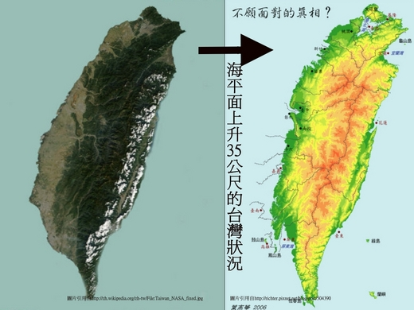

Global warming

Slide 4
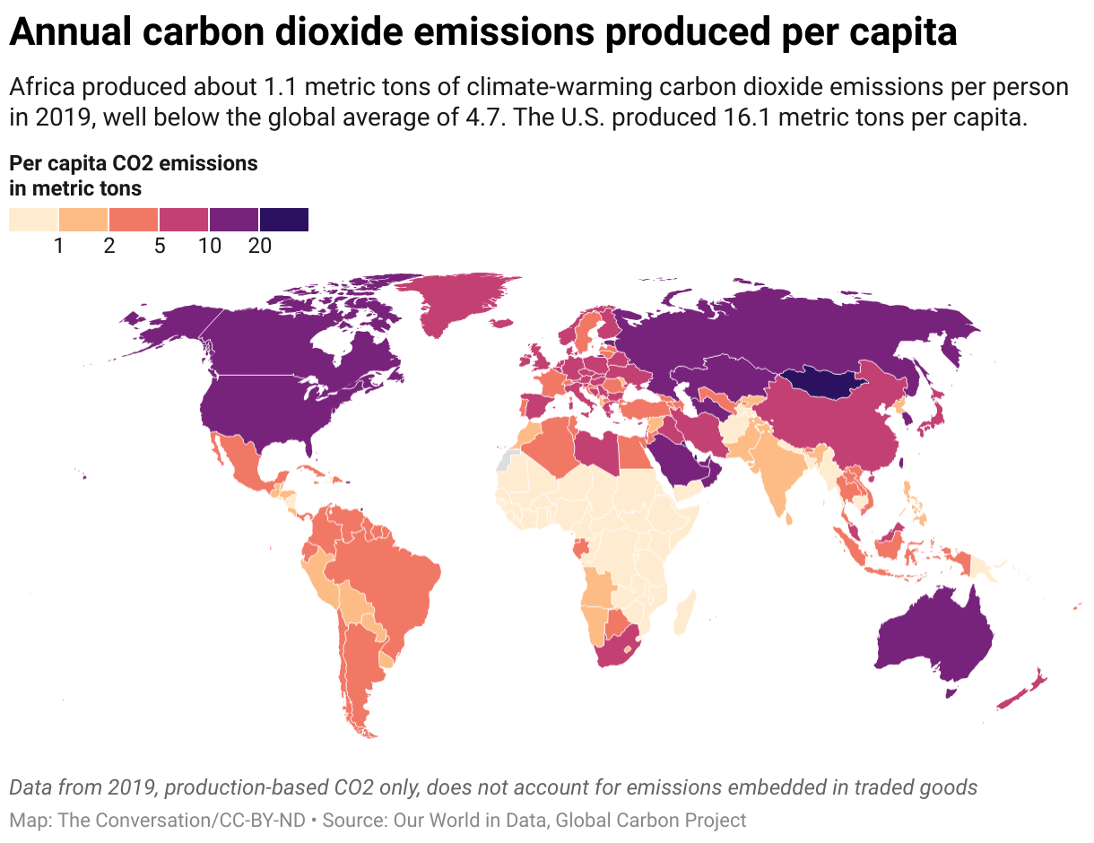
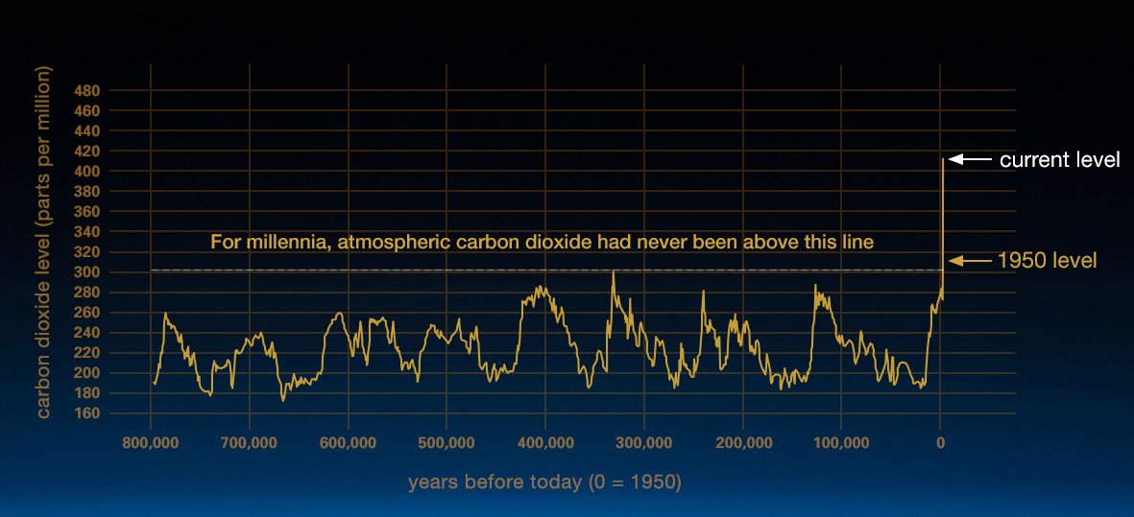
Global warming -CO₂ issues

Slide 5
Background
Concentration in atmosphere
420.8 ppm (2022)
376.6 ppm (2000)
36.4 Gton/y (2021)
Annual global emission rate
25.0 Gton/y (2020)
+1.2 ° C (2021)
Averaged global temperature
+0.7 ° C (2000)

Slide 6
Background
Excessive emissions of greenhouse gases (especially CO₂) brings serious climate changes.
Carbon capture and storage /utilization.
Taiwan targets on reaching net zero emission by 2050.

Slide 7




CO₂ Capture and Utilization (CCU)
CO₂
Absorption
Methanol
CO₂
Capture
Utilization
$$CO_{2}+H_{2}↔CO+H_{2}O$$
CO₂
$$CO_{2}+3H_{2}↔CH_{4}O+H_{2}O$$
$$CO+4H_{2}↔CH_{4}O+H_{2}O$$

Slide 8
02
CO₂-to-Methanol Process

Slide 9
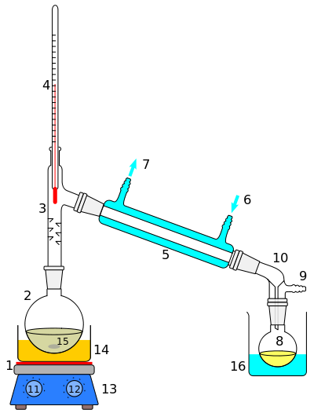
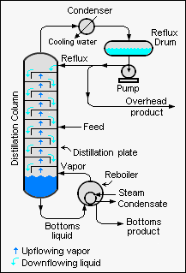
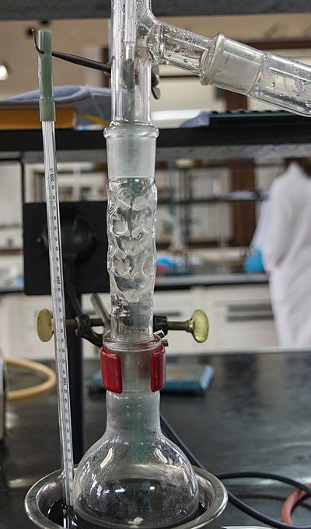
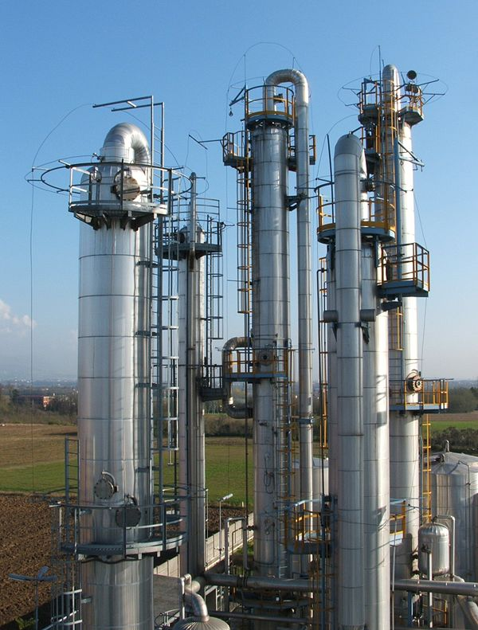
Fractionating column （蒸餾塔）
Laboratory fractionating columns
Industrial fractionating columns

Slide 10
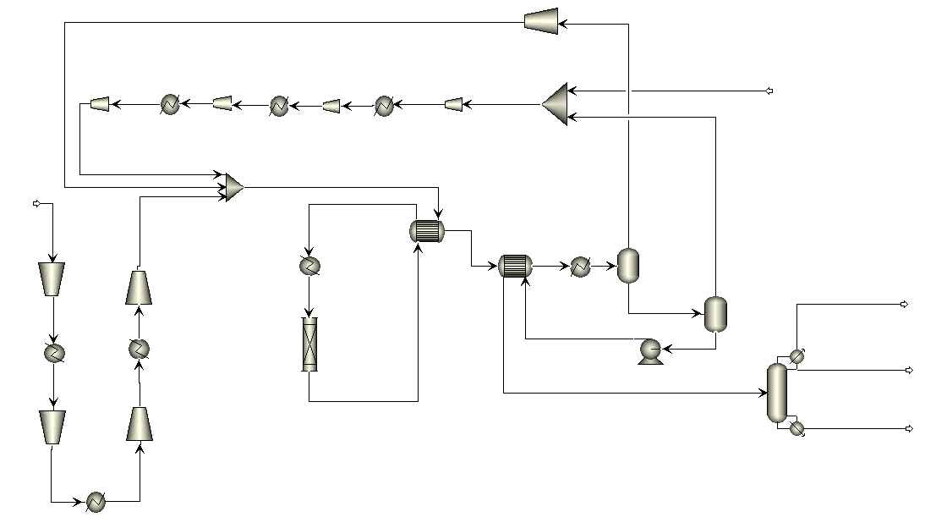
Process Flowsheet
Compressor
CO₂ Feed
(From powerplant)
H₂ Feed
Heat
Exchanger
Flash
Separator
Fuel Gas
Cooler/Heater
Methanol
(> 99.5 wt%)
Reactor
Water
(> 99.9 wt%)
Distillation Column

Slide 11
Process Unit
Reactor
Flash Separation
Heat Exchanger
V
Cold
CO₂
CH₃OH
V+L
Hot
Hot
H₂
H₂O
Cold
L
Where chemical reaction takes place
Performs vapor (V) / liquid (L) split
Performs energy change in between process streams (from hot one to cold one).

Slide 12
Process Unit
Distillation Column
Cooling
Phase equilibrium data for design
A
Y
Separating mixtures based on boiling points
Light up, heavy down
V/L separation on plates
Heating and cooling required
Widely used in industry
A+B
。。。
B
Heating
X

Slide 13
Process Unit
Distillation Column
Cooling
Phase equilibrium data for design
A
Y
Separating mixtures based on boiling points
Light up, heavy down
V/L separation on plates
Heating and cooling required
Widely used in industry
A+B
。。。
B
Heating
X

Slide 14
03
Scope of Proposal

Slide 15
A Chemical Process Cares about …
Safety
Economics
$
Quick disturbance rejection.
Early abnormality detection
Stable operation.
Good productivity.
Good product quality.
Efficient energy usages

Slide 16
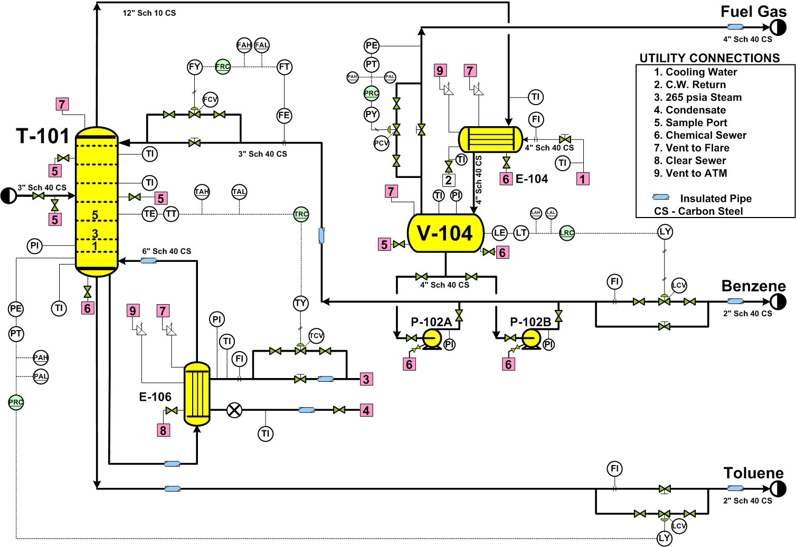
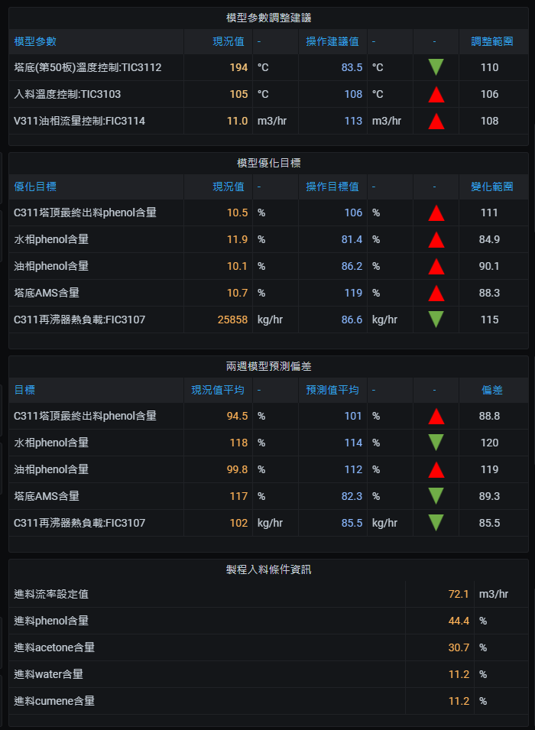
A Chemical Process has :
Various sampling and measurement.
recording/monitoring system
Non-disclosed
Non-disclosed
Non-disclosed
Non-disclosed

Slide 17

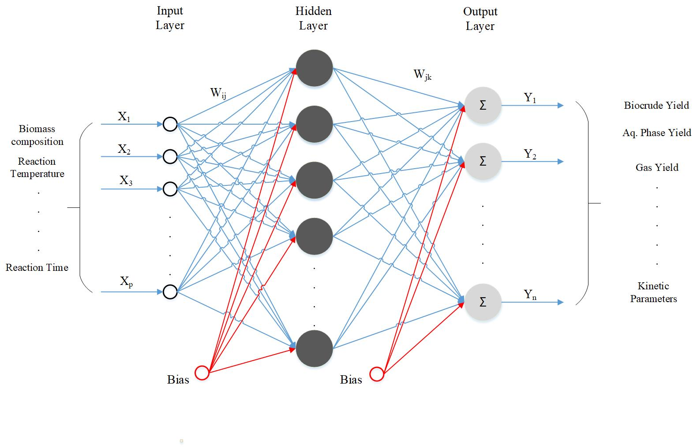
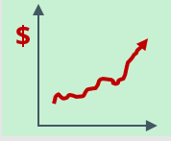
Using ML Techs in Industry
Data-based model
(For online uses)
Plant Data
Machine
Learning
＄

Slide 18
Be Careful about :
Measurement
Time Effect
Data Variability
Process Knowhow
Some variables are slowly measured or not readily measurable.
Changes on variables are not instantly reflect.
Collect large volume of data with low variability (stable operation)
Need to know the procedure

Slide 19
Thanks

